Slide 1
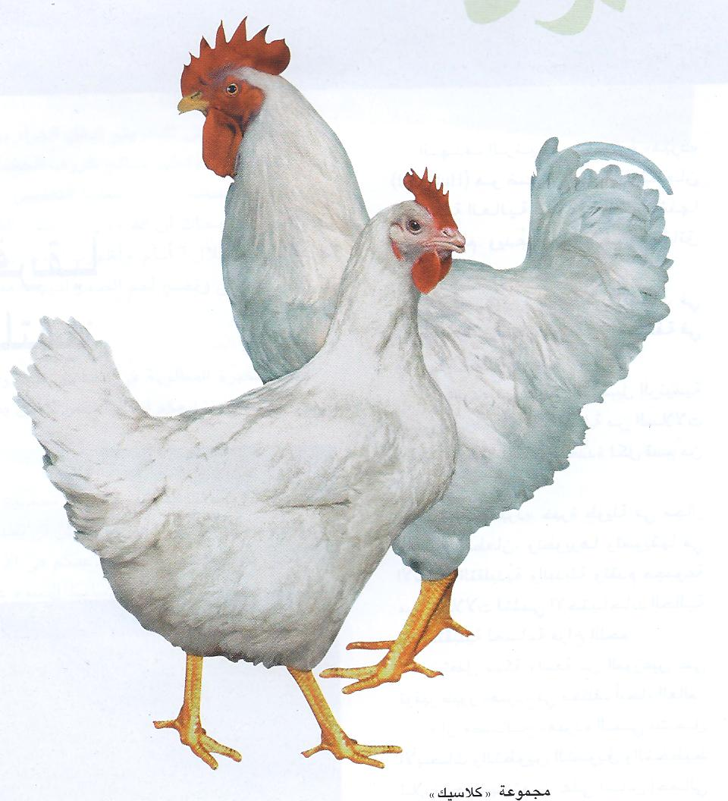
Regulation of Feed Intake

Slide 2
Summarized & Presented By Ahmed M. Al-Zahrani – PhD student Animal Science Department Physiological Digestibility in Monogastric Advisor Prof. Tarek Shafey

Slide 3
Contents
Introduction.
Why this presentation?
A System for Regulating Feed Intake
Short-Term System
Long-Term System
An Integrated Regulator System
Neuropeptidergic Regulation of Food Intake
Orexigenic Neuropeptides
Anorexigenic Neuropeptides
Conclusions

Slide 4
Introduction

Slide 5
Neurotransmitters :
Chemicals transfer signals between a neuron and another cell
Effect depend on the anatomical site (eg, norepinephrine increases feeding when infused into the paraventricular nucleus but decreases feeding when injected into the lateral hypothalamus)
BW is constant/homeostatic even with ad libitum (the concept of short-and long-term control of food)
FI regulation in the brain involves neuropeptides (orexigenic or anorexigenic)

Slide 6
Within the CNS, the brainsteam & the hypothalamus play critical roles in the regulation of FI & EB.
The CNS of chickens regulates FI similar to mammals.
regulation of FI and EB in birds and mammals involves similar: regulatory mechanisms, neural pathways and neuroanatomical sites
Notes:
هل يمكن جمع النقطة الثانية والثالثة مع بعض

Slide 7
Why this presentation?

Slide 8
To strengthen our understanding of nuropeptides controling:
Feed Regulation & EB
Not only say “ Because of genetics !!”
Important for growth and health to understand factors involved in feeding behavior

Slide 9
A System for Regulating Feed Intake (Short & long-term system)

Slide 10
Regulations of FI include a central system to control FI
This CS comprises specific neural sites and circuits in the brainstem and hypothalamic regions.
That receives input from two major peripheral systems

Slide 11
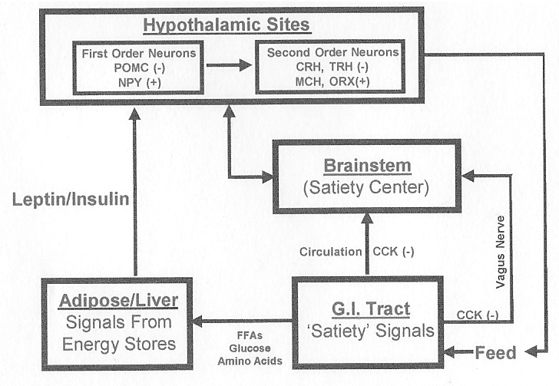
Regulating FI in Poultry

Slide 13
1- Short-Term System

Slide 14
The Satiety signals which influence satiety center of hypothalamus are:
Absorption of nutrients from the digestive tract
Presence of nutrients in the circulating blood
Control of FI in short term (meal to meal):
Involves hormonal and neural signals
Originate in the gut, pancreas and liver

Slide 15
Peptide satiety signals produced by gastrointestinal tract:
Ghrelin: stimulate feeding behavior
CCK & Bombesin: ↓h it
Peptide Satiety signals:
Brainstem → hypothalamus (Why?)
To activate neural pathways
That modulate FI in the short-term

Slide 16
2- Long-Term System

Slide 17
Activated in the hypothalamus & maintained constant BW even if it is altered by
Starvation
Or forced feeding
The net result is a system that:
Cumulatively regulates meal-to-meal FI
Long-term maintenance of energy (fat) storage
Achieve EH and stability in BW

Slide 18
Hypothalamus :-
Contains: Multiple peptidergic neuronal pathways
Involved: Regulation of FI & EH
These pathways are:
Anabolic: Mediates a net increase in EI and storage
Catabolic: Results in a net decrease in EI and storage
Changes in the circulating level of leptin & insulin:
Signal the hypothalamus to effect LT changes in EB
By activating or inhibiting specific anabolic & catabolic efferent pathways

Slide 19
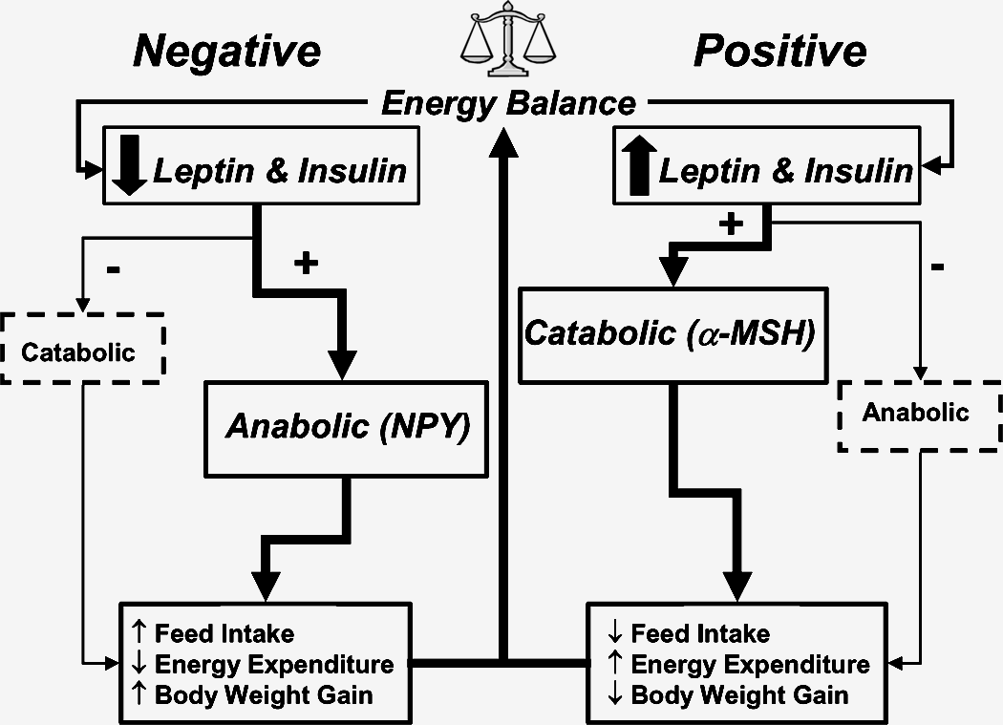
Model for LT of EB & BW

Slide 20
Numbers of signaling molecules function in peripheral and central sites to activate specific neural circuits that effect changes in FI as well as in EM.
But these Signals need receptors

Slide 21
Anorexigenic/catabolic | Orexigenic/anabolic
Leptin1 | Neuropeptide Y (NPY)1
-Melanocyte stimulating hormone (α -MSH)1 | Agouti-related peptide (AGRP)1
Corticotrophin releasing hormone (CRH, CRF) (MCH) | Melanin concentrating hormone
Thyroid releasing hormone (TRH) | Orexins/hypocretins3
Cholecystokinin (CCK) | Peptide YY (PYY)
Bombesin/gastrin releasing peptide (GRP) | Pancreatic polypeptide (PP)
Ghrelin2 | Galanin
Somatostatin (SIRF) | β-Endorphin
Notes:
I write the comment on this table from the article

Slide 22
Anorexigenic/catabolic | Orexigenic/anabolic
Gastrin | Dynorphin
Calcitonin gene-related peptide (CGRP) (GHRH) | Growth hormone releasing hormone
Urotensin I/urocortin | Norepinephrine
Neurotensin
Glucagon/glucagon-like peptide 1 (GLP-1)
Serotonin
Dopamine
Epinephrine

Slide 23
An Integrated Regulatory System

Slide 24
The coordinate regulation of FI and EB involves:
Environmental cues (feed availability, photoperiod, and temperature)
Internal physiological signals (hormone levels, metabolite levels, and energy stores).
The brain plays a pivotal role in this process of integration.

Slide 25
Neuropeptidergic Regulation of Food Intake

Slide 26
1- Orexigenic Neuropeptides

Slide 27
Neuropeptide Y (NPY):
Neuropeptide Y (NPY) stimulates FI chicken & mammals.
Peptide YY was much more potent than NPY in eliciting food consumption

Slide 28
(2) Opioids:
ICV of δ- and Ќ-opioid receptor agonist stimulated FI in chicks
Opioids, act on the μ and/or δ-opioid receptor have an important role in feeding behavior in the CNR of broiler
μ1-opioid has relation to NPY-induced feeding

Slide 29
(3) Arg-Phe-NH2 (RFamide):
Two RFamides have been revealed as orexigenic factors in neonatal chicks (PrRP & GnIH).
a- (PrRP):
Acts as prolactin release inhibitory peptide & orexigenic factor in chicks - reverse in mammals
Central administration ↓ FI in rats.
ICV injection ↑ FI in chicks.

Slide 30
b- (GnIH):
The ICV injection of GnIH, GnIH-RP-1 and GnIH-RP-2 significantly stimulated FI in chicks.
ICV human QRFP showed no signiﬁcant effect on FI

Slide 31
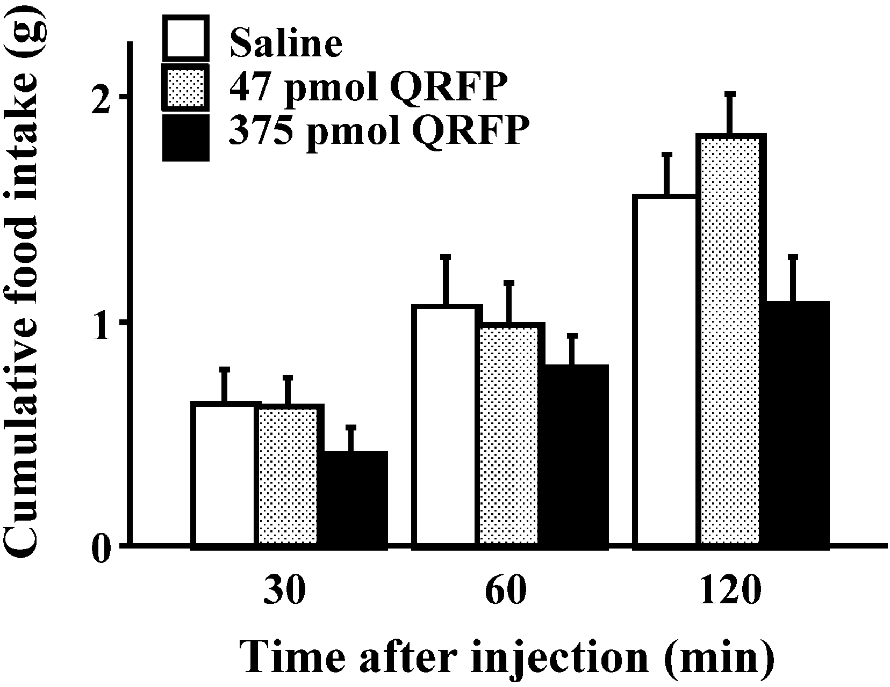

Slide 32
2- Anorexigenic Neuropeptides

Slide 33
Glucagon Superfamily
It regulate appetite in the chick brain as an anorexigenic factor
Central administration of GLP-1 strongly ↓h FI of neonatal chicks
(GRF) is known to stimulate feeding behavior in rats

Slide 34
(2) Gastrin/Cholecystokinin (CCK) Family
a- CCK:
↓ FI in chickens:
When injected directly into CNS
Also with Peripheral injections.
Stimulate gastric emptying & the release of pancreatic enzymes to aid in the digestion of feed
Satiety signal to the brainstem & depressing appetite and, hence, the drive to feed.
If injected intravenously → abdominal discomfort → ↓ FI (indirect)

Slide 35
b- Gastrin
ICV injection of chicken gastrin inhibits FI and FP in chicks.
Subcutaneous injections of the C-terminal decapeptide of chicken gastrin ↓h FI

Slide 36
(3) Corticotropin-Releasing Factor (CRF) Family
CRF decreased FI in chicks.
There are two CRF receptor subtypes:
(CRF1R) & (CRF2R), in fish, amphibians, chickens and mammals.
The CRF1R antagonist did not compete with CRF in suppression of FI in mice
on the contrary, the CRF2R antagonist completely reversed the anorexigenic action of CRF in rats, suggesting that CRF suppresses FI via the CRF2R.

Slide 37
(4) a-Melanocyte Stimulating Hormone (MSH)
a-MSH, ↓h FI of mammals.
ICV of a-MSH ↓h FI in 3h fasted chicks in a dose-dependent.
a-MSH strongly ↓h NPY-induced feeding
The POMC produce bioactive α-MSH which play an important role in regulating FI in chickens.

Slide 38
(5) Bombesin
In turkeys, ↓ food & water intake in both the peripheral and CNS
(due to discomfort rather than a anorexigenic effect)
ICV injection in neonatal chicks ↓h FI
Central administered NPY-induced FI was suppressed by coinjection of bombesin.

Slide 39
(6) Ghrelin
In rats, central and peripheral ghrelin ↑ FI mainly through the activation of NPY neurons.
ICV injection of ghrelin ↓h FI in chickens.

Slide 40
(7) Arginine-Vasotocin (AVT)
AVT is a stress-related peptide in the brain of birds
ICV injection of AVT:
↓h feeding behavior
↑ rectal temperature
↑ plasma corticosterone concentrations

Slide 41
(8) Glutathione
ICV injection of GSH dose-dependently ↓ FI in chicks.
The ↓ in FI induced by a hypnotic effect of GSH.
(9) Carnosine
Present in high concentration in the muscle & brain of mammalian & avian species
ICV ↓h FI in a dose-dependent

Slide 42
Conclusion

Slide 43
Short-term Involves hormonal and neural signals originate in the gut, pancreas and liver.
Long-term maintain EH & stability in BW
(by activating or inhibiting specific anabolic and catabolic efferent pathways)

Slide 44
Some anorexigenic effect may indirect
(caused by abdominal discomfort)
Neuropeptides function in avian & mammals will be either:
Anorexigenic in one but orexigenic in the other
Anorexigenic in both or orexigenic in both

Slide 45
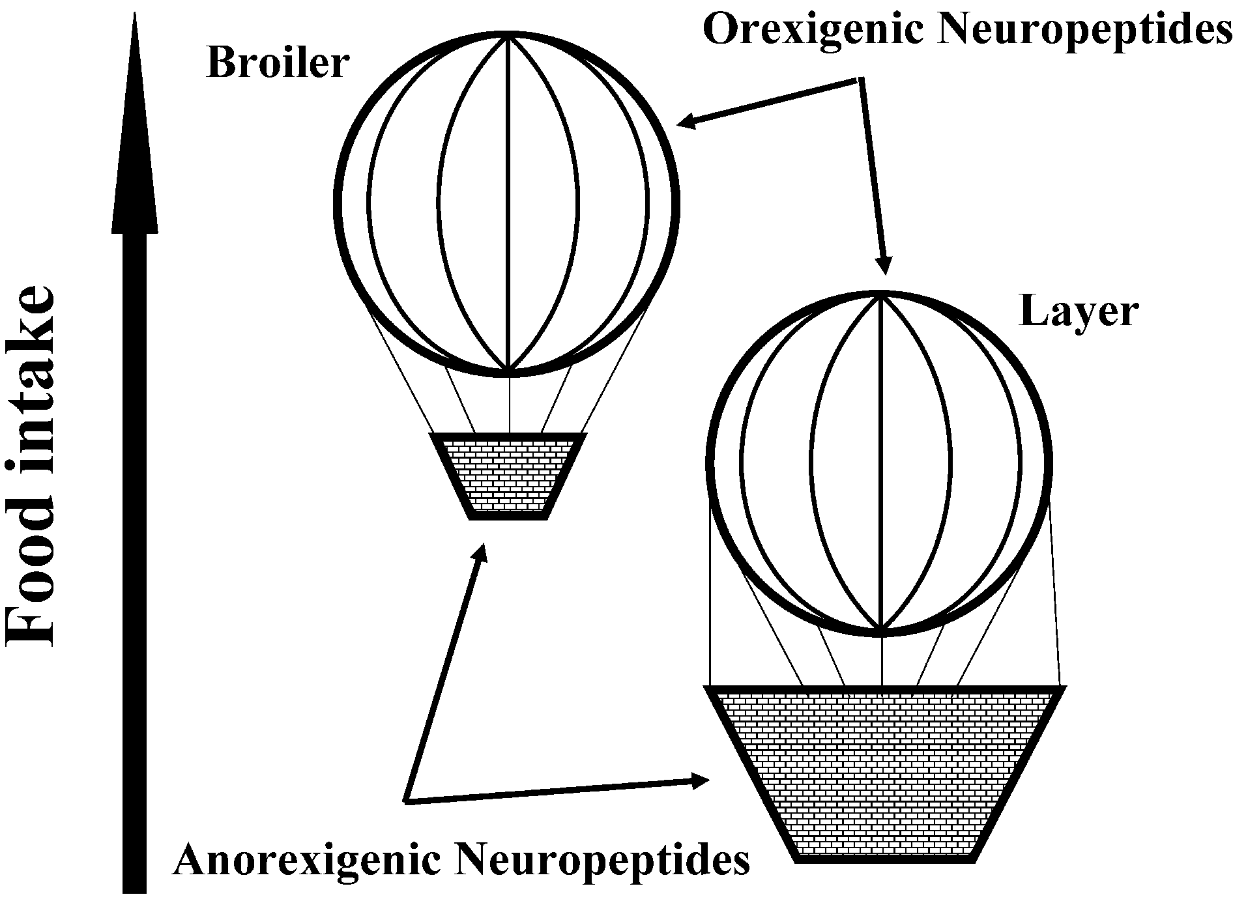
Difference in FI (Broiler and Layer)

Slide 46
Thank You For Attendance

